Slide 1
Sudoku Solver using Threading, Mutex’s, and CV’s
Adam Abdelrehim

Slide 2
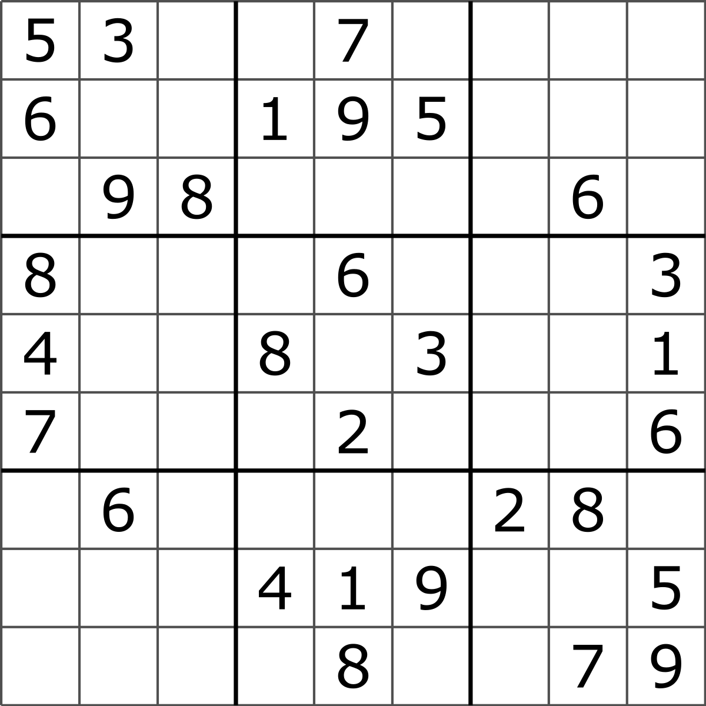
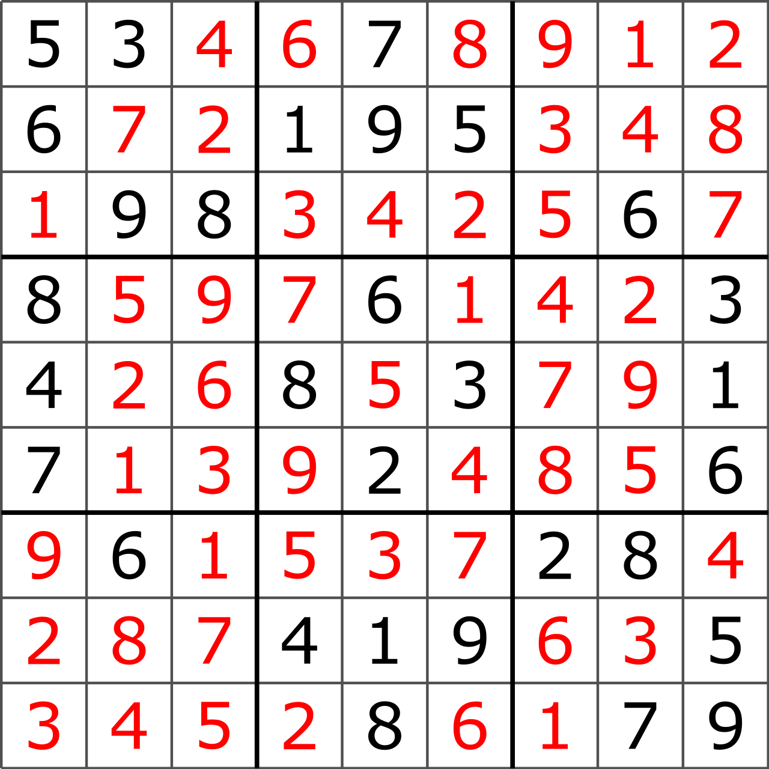

Objectives
Create a Sudoku solver that utilizes OS resources in order to effectively return solutions to user input
Inspiration: NYT Daily Sudoku Puzzle
Language Used: Python

Slide 3
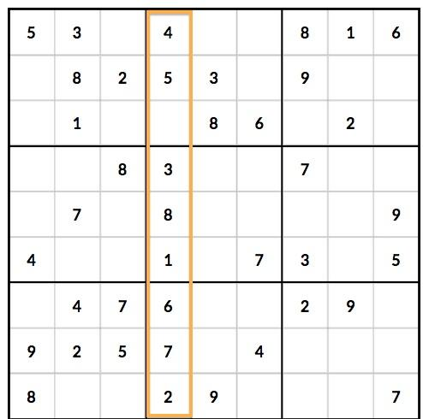
Recap: Sudoku Rules
In a given 9x9 square, with 3x3 subsections, the following rules must be upheld:
Each subsection must contain the numbers 1 through 9 exactly once
Each row and column must contain the numbers 1 through 9 exactly once
Typically, puzzles only have one solution, although multiple are possible in poorly designed puzzles
9

Slide 4
Recap: What are Mutexs?
Mutexs are mechanism used to ensure that multiple concurrent threads do not try to execute a critical section of code simultaneously
Without mutexs, a program might run into a race condition, in which the system will attempt to perform two or more operations at the same time, and two or more threads access shared data
Obviously, this is not ideal, which is why mutexs only allow one thread to access data at the same time

Slide 5
Recap: What are Conditional Variables?
Conditional variables are special variables that determine if a condition has been met
It allows communication between threads
“A conditional variable is like a queue. A thread stops its execution and enters the queue if the specified condition is not met. Once another thread makes that condition true, it sends a signal to the leading thread in the queue to continue its execution.”

Slide 6
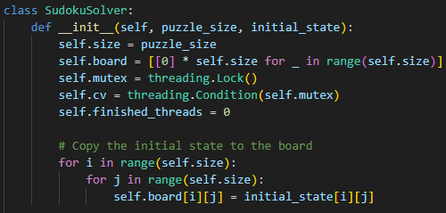
Python Implementation

Slide 7
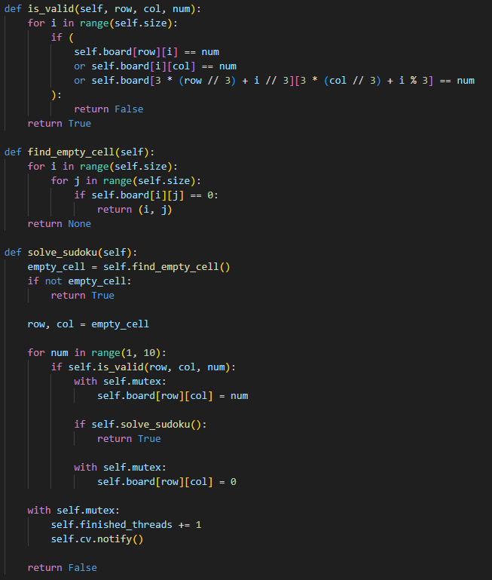
Python Implementation p.2

Slide 8
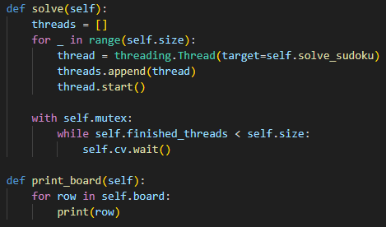
Python Implementation p.3

Slide 9
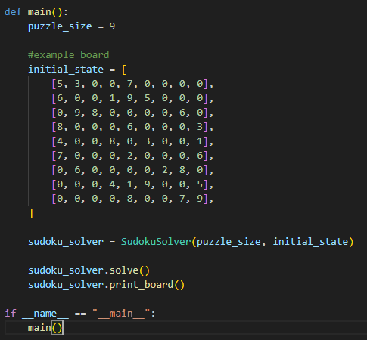
Python Implementation p.4

Slide 10
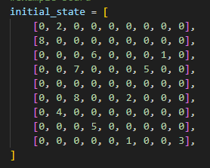
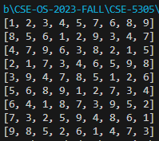
Example Running

Slide 11
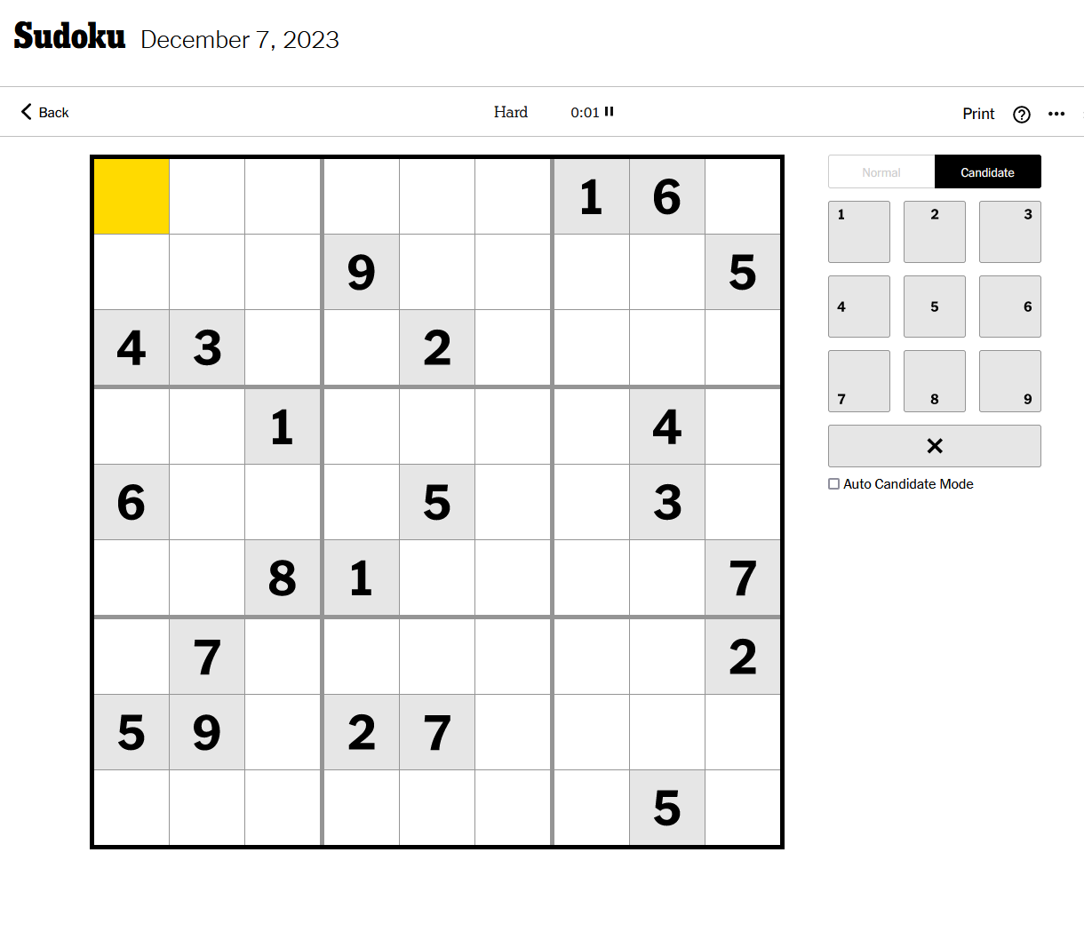
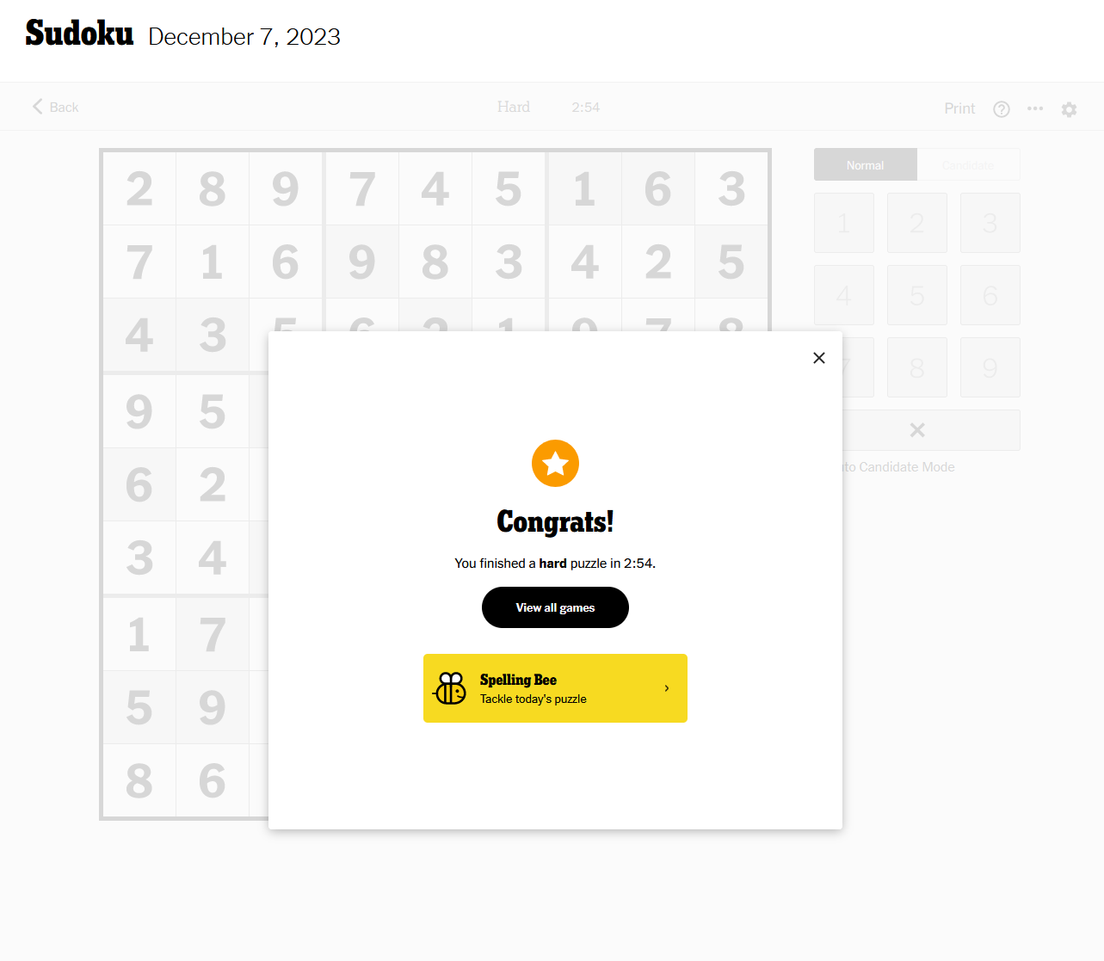
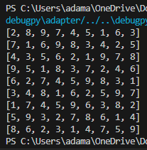
Solving Today’s New York Times Sudoku

Slide 12
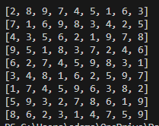
Potential Issues:
Cannot decipher when an inputted puzzle breaks the rules by having more than one of a specific number in either a row, column, or box
Potential fixes: Add a check after a puzzle is returned that the returned solution is valid, instead of assuming it is

